Slide 1
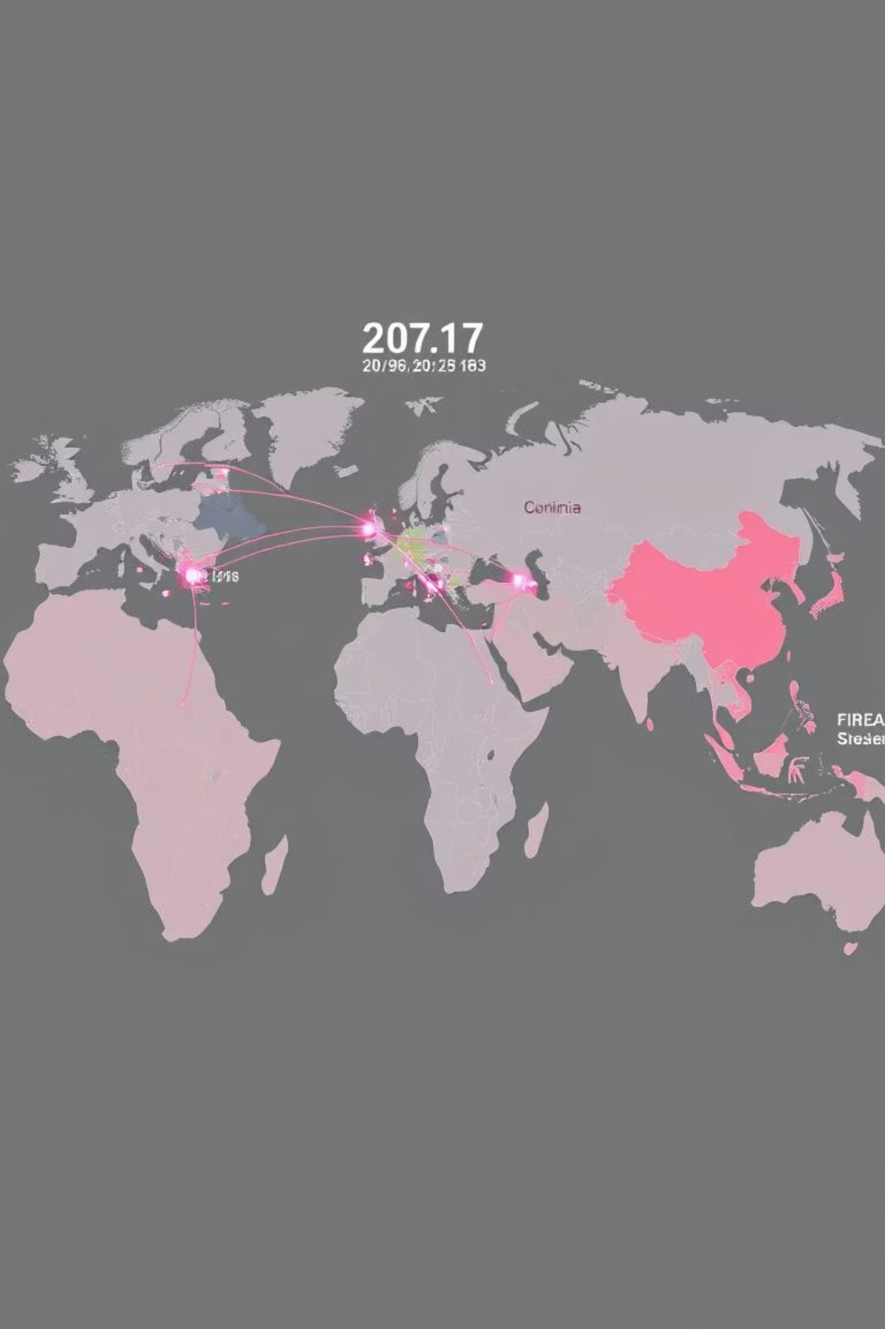
Dynamics in Global Military Expenditure
Implications for India
Presented by: MITVA NAIK
September 3, 2025

Slide 2





Introduction & Project Goals
This project analyzes global military spending, arms transfers, and India's defense priorities amidst evolving security challenges and new technologies.
Global Spending Trends
Understand worldwide military expenditure patterns.
India's Position
Compare India with other major military powers.
Identify Gaps
Pinpoint opportunities and weaknesses in India's defense strategy.
Data-Driven Recommendations
Provide policy recommendations based on analysis.

Slide 3




Core Data Sources
Our analysis relies on robust datasets from leading international organizations.
SIPRI Military Expenditure
SIPRI Arms Transfer
World Bank - Military % GDP
Annual military spending data by country in constant USD.
Data on international transfers of major conventional weapons.
Country-wise defense spending as a percentage of GDP.
Link to SIPRI
Link to SIPRI
Link to World Bank

Slide 4

Methodology: Data Preparation
Our rigorous process ensures data accuracy and relevance for analysis.
01
Data Collection
Raw datasets downloaded from SIPRI and World Bank.
02
Data Cleaning
Dropped unnecessary columns, changed data types, reshaped tables, and filtered for 2014-2024 to avoid bias from missing older values.
03
Format Conversion
Excel files converted to CSV for consistent processing.
04
Cleaned Data Storage
Saved datasets for further use in Python and visualization tools.

Slide 5
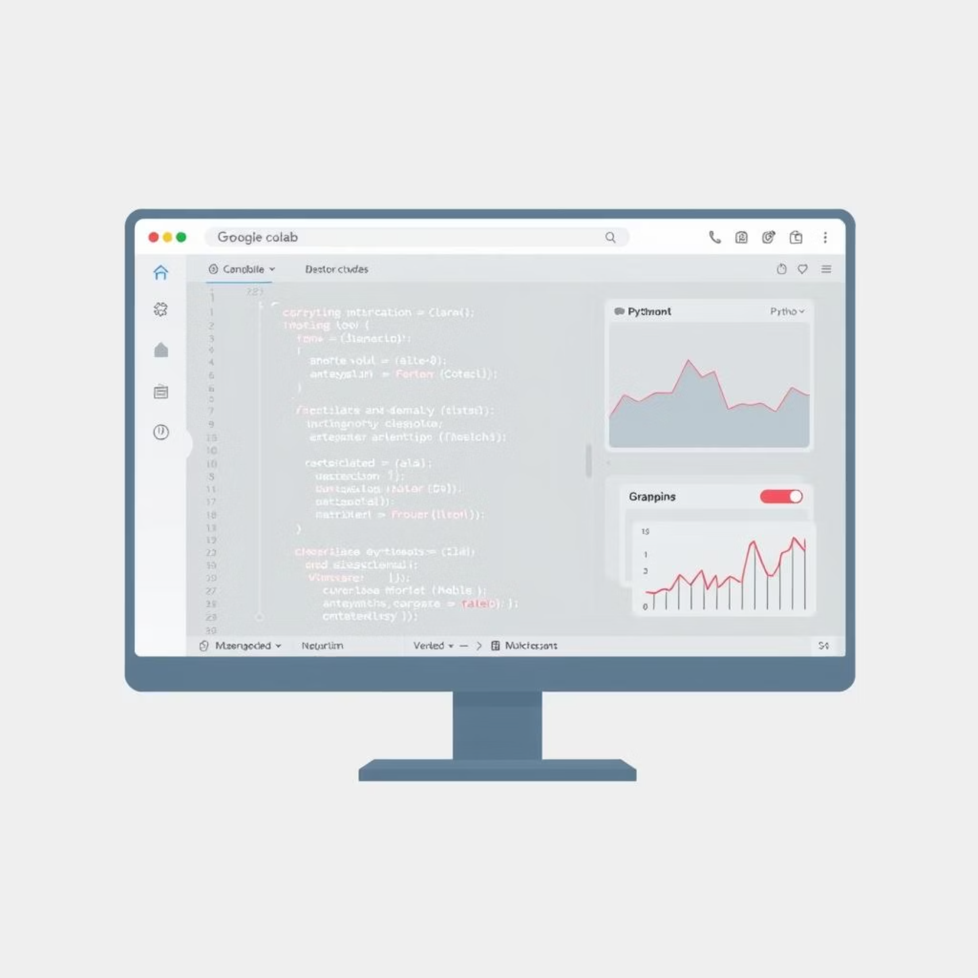
Methodology: Analysis & Comparison
Advanced tools and techniques were used to derive meaningful insights.
Python Analysis
Conducted in Google Colab, creating line charts, bar plots, and trend graphs, primarily focusing on 2014-2024 data.
Comparative Analysis
Compared India's expenditure and imports against other major military powers.
Access the Google Colab file for detailed code and analysis.

Slide 6
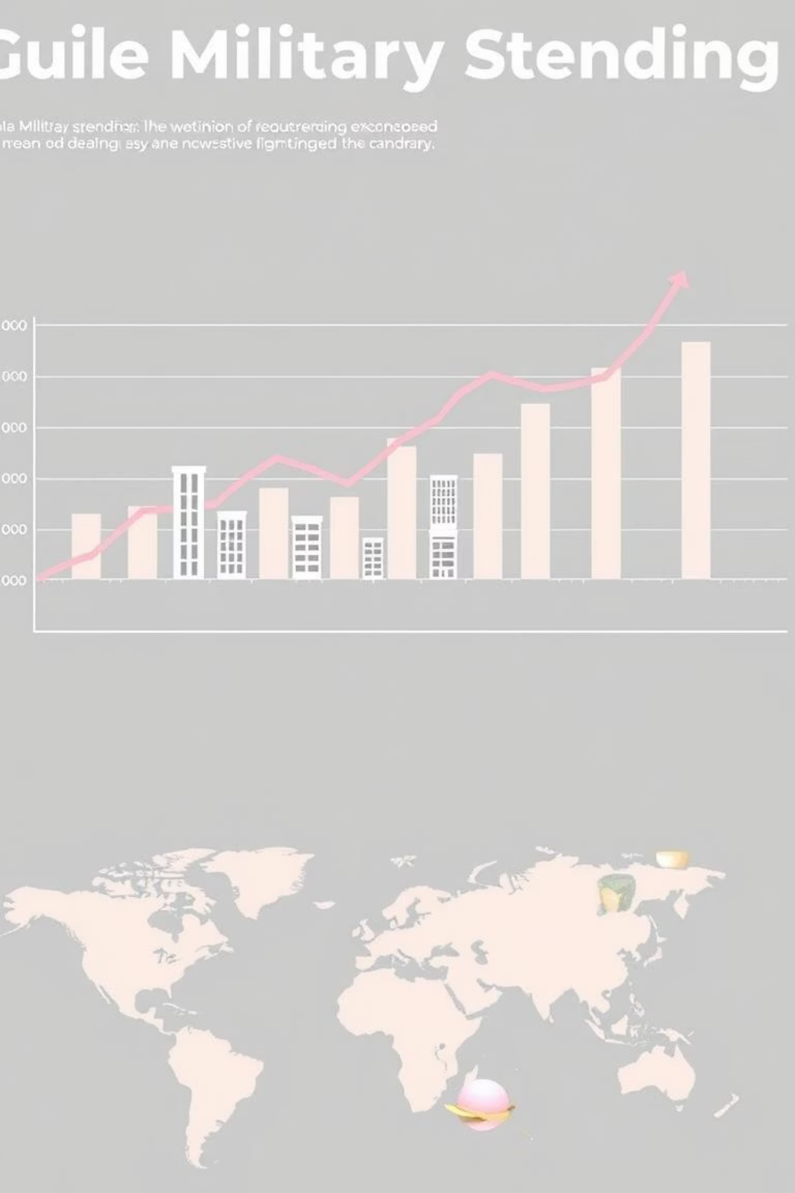
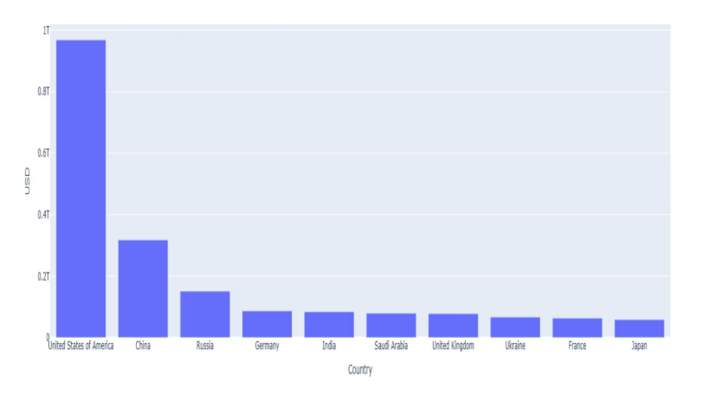
Global Military Spending Trends (2014-2024)
Global defense spending rose sharply from under USD 2 trillion in 2014 to over USD 2.6 trillion in 2024, reflecting geopolitical tensions and modernization drives.
The United States dominates global defense spending. India ranks fifth, driven by regional threats and modernization efforts, yet still relies heavily on arms imports.

Slide 7
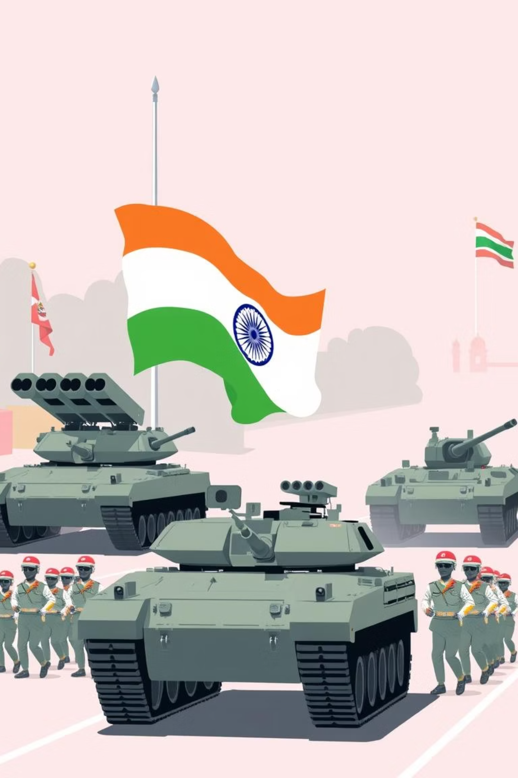
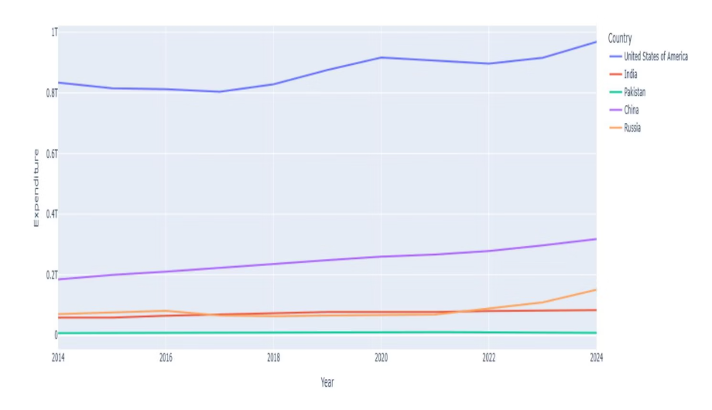
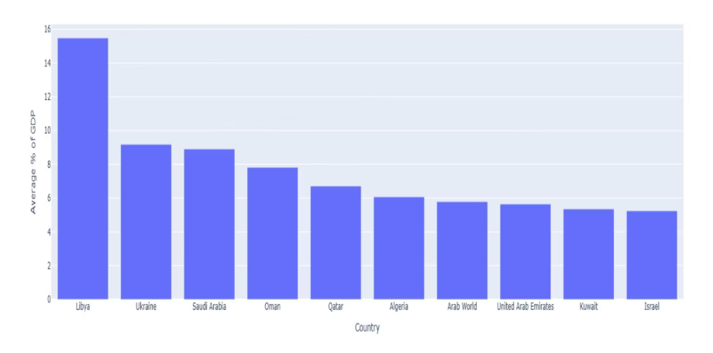
India's Spending: Peers & % GDP
India's military expenditure as a % of GDP is modest (2-2.5%), not appearing in the top 10. This suggests a balanced approach relative to its economic size, unlike conflict-prone or resource-rich nations.
India's defense expenditure shows a steady trend, unlike the steeper upward trends of peers like the US and China. This highlights a need for optimized spending towards self-reliance.

Slide 8
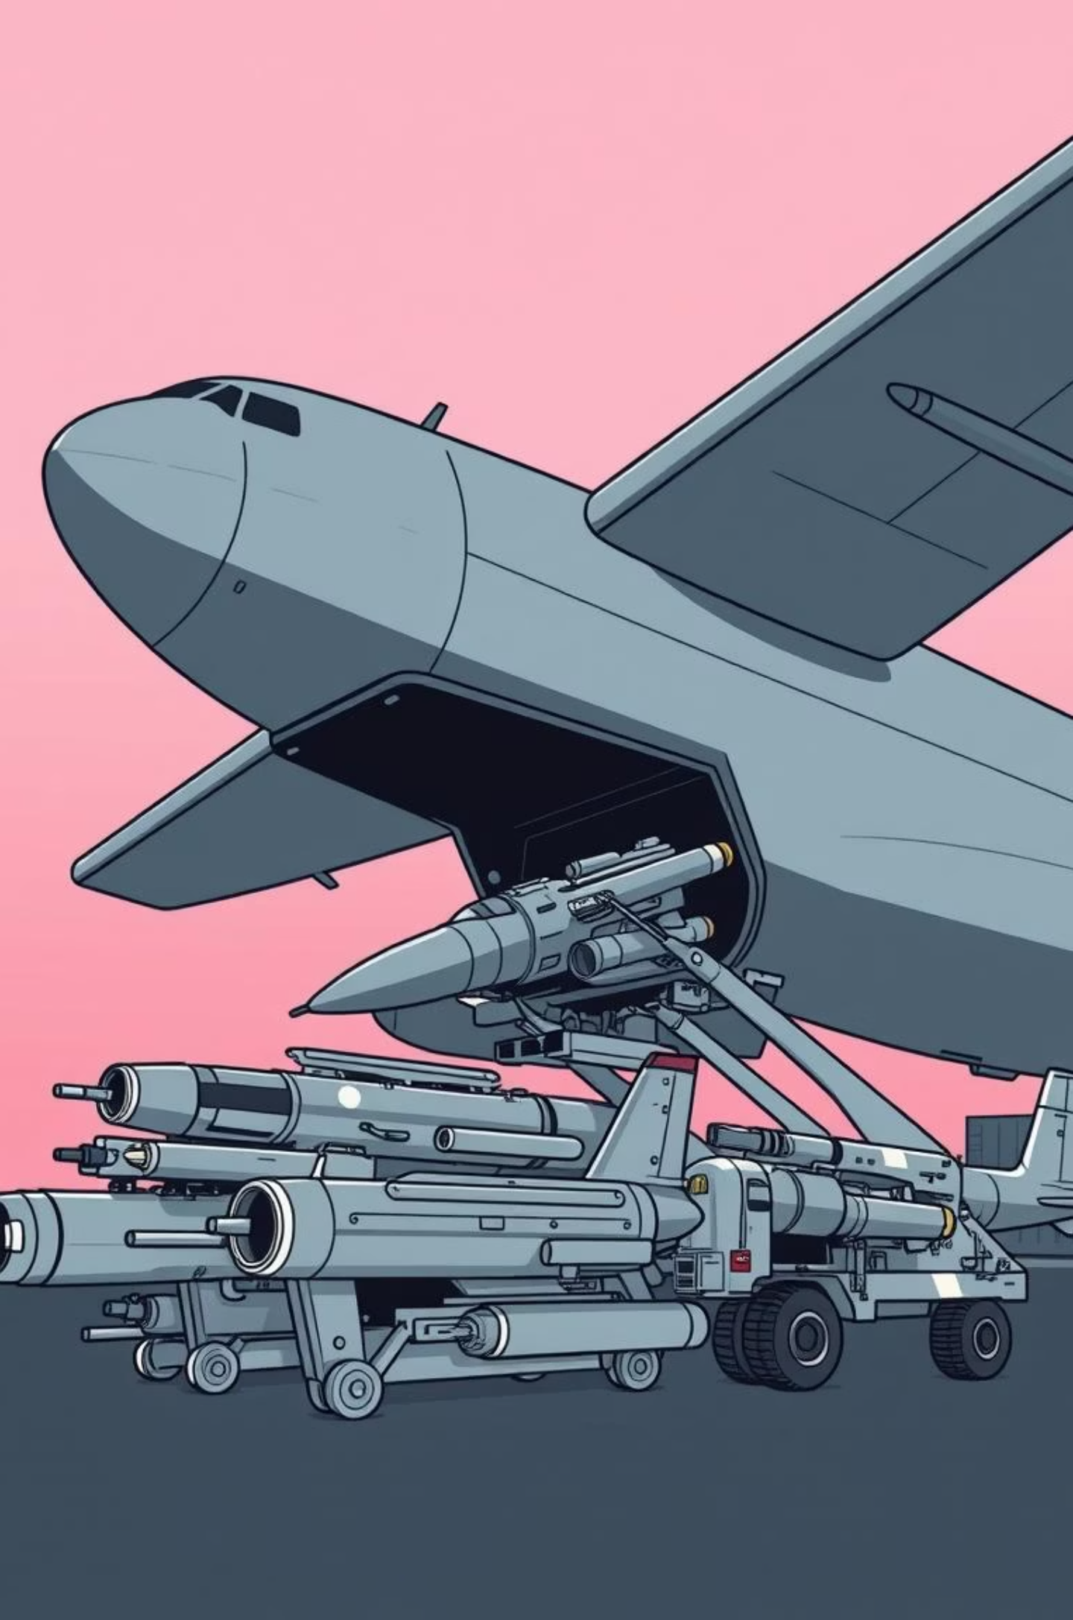

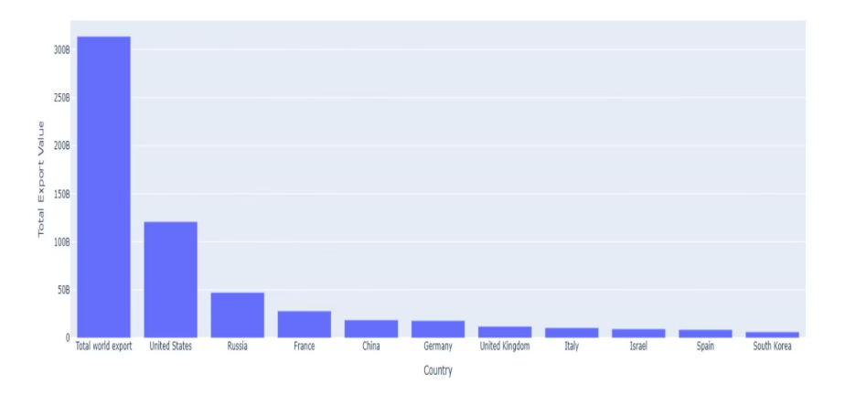
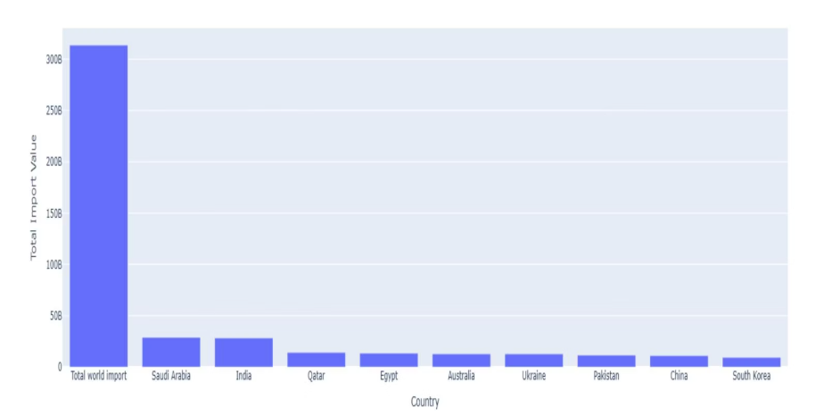
Global Arms Trade: Imports & Exports
The global arms market reveals significant disparities in import and export capabilities.
Conversely, India is absent from the top ten arms exporters. The United States remains the leading global arms exporter, dominating the market.
India ranks among the top five arms importers, underscoring its reliance on foreign defense equipment.

Slide 9

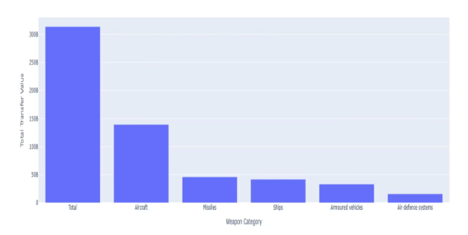
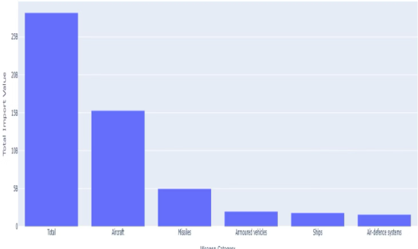

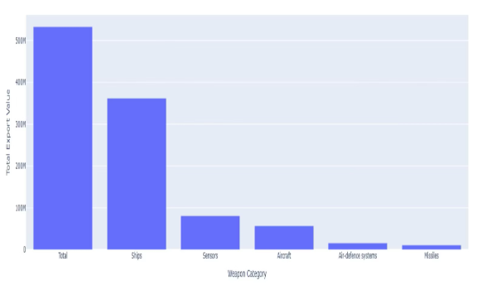
Weapon Transfers: Global & India Specific
A closer look at the types of weapons transferred globally and by India.
Global top five weapon transfers exceed USD 300 billion, with aircraft, missiles, and naval ships dominating, indicating a focus on air and strategic capabilities.
India's top five weapon imports are over USD 25 billion, primarily aircraft, missiles, and armored vehicles, highlighting efforts to enhance air and ground capabilities.
India's top five weapon exports amount to over USD 500 million, led by ships, sensors, and aircraft, showing a smaller but diversified export profile.

Slide 10
Key Insights & Recommendations for India
Global Spending Surge
India's Import Reliance
Dominant Arms Industry
Military expenditure is at record highs due to geopolitical tensions.
India remains a top importer, indicating limited domestic production.
US and China lead, while India has limited global presence.
Recommendations
Increase investment in defense R&D (AI, cybersecurity, drones, space defense).
Strengthen domestic arms production to reduce import dependency.
Promote defense exports, focusing on proven capabilities like ships and sensors.
Conclusion
Global military spending is rising. India must reduce import reliance, prioritize domestic innovation, R&D, and partnerships. A shift to advanced technologies will strengthen national security and position India as a global defense leader.

Slide 11
Thank You

